Slide 1
Tableau Project
Jagdish Lohni
Video Link
https://drive.google.com/file/d/1fF_W9HeD1bfNb2rMjawtU_Fvhg3VQ3PD/view?usp=sharing

Slide 2
Problems
What is Yearly and Monthly Sale Report
Most Profitable Product Sub Category
Top Profitable Region
Product Profit Loss Report
Maximum Selling Category
Consumer segment
Top 10 Customer
Make A User Fendley Sales Dashboard

Slide 3
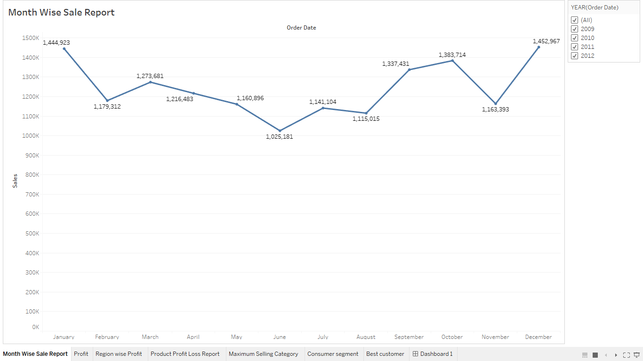
Yearly and Monthly Sale Report

Slide 4
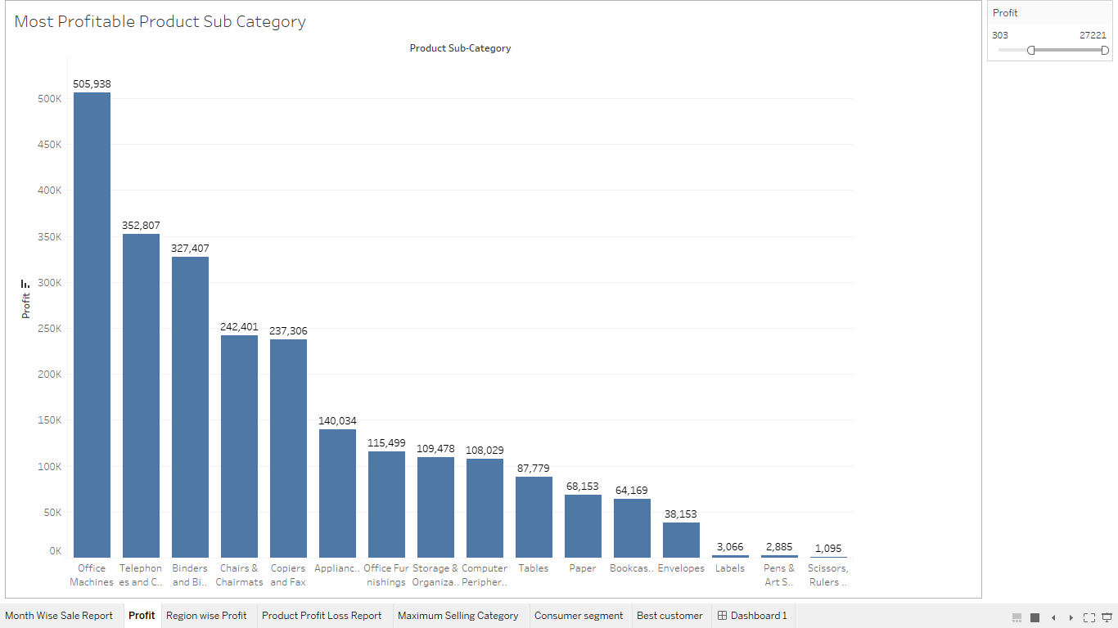
Most Profitable Product Sub Category

Slide 5
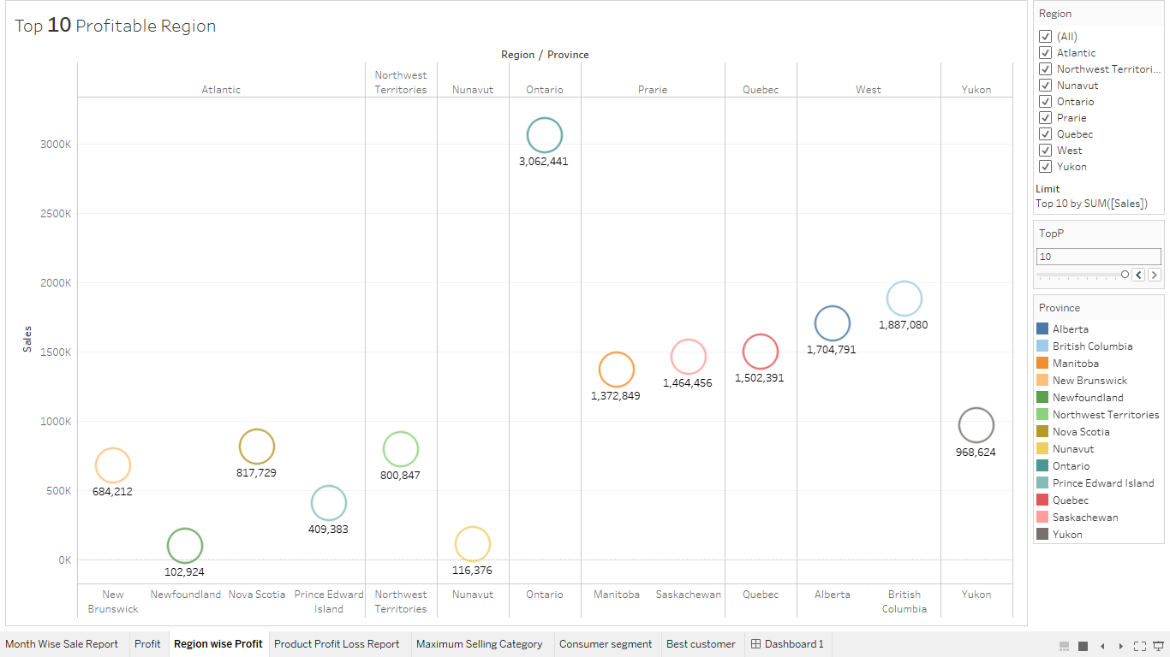
Top Profitable Region

Slide 6
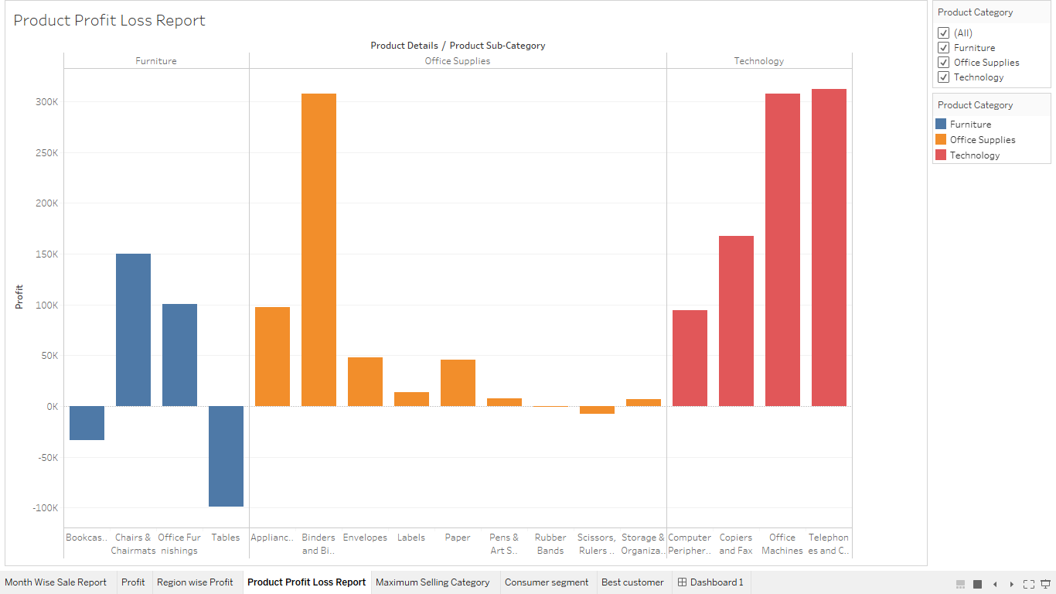
Product Profit Loss Report

Slide 7
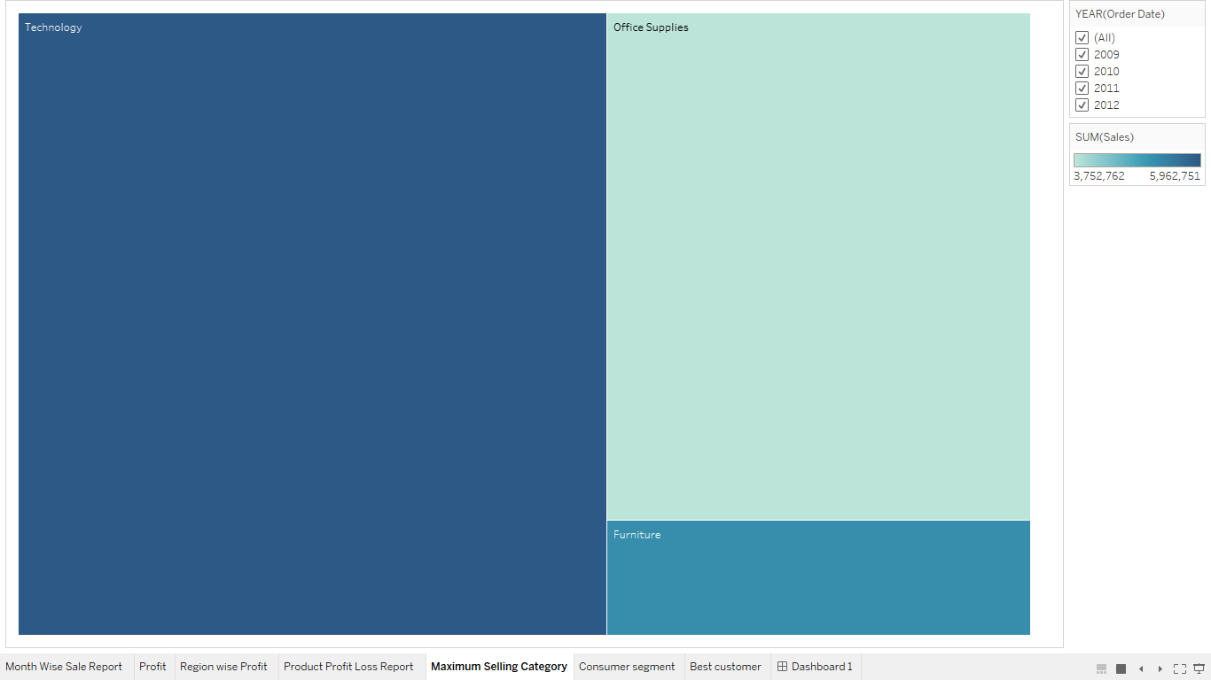
Maximum Selling Category

Slide 8
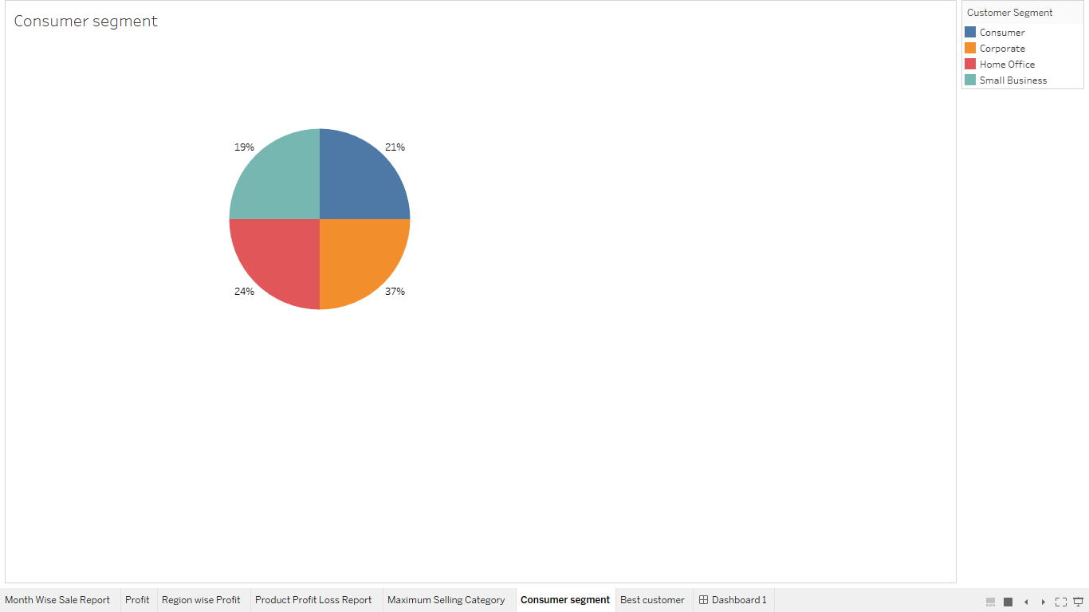
Consumer segment

Slide 9
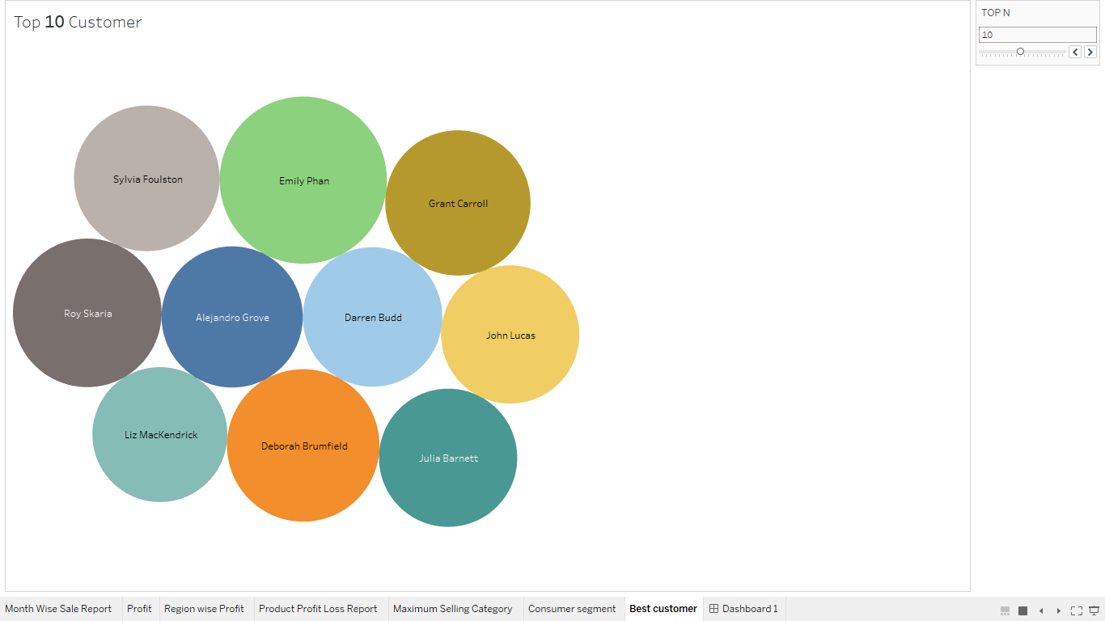
Top 10 Customer

Slide 10
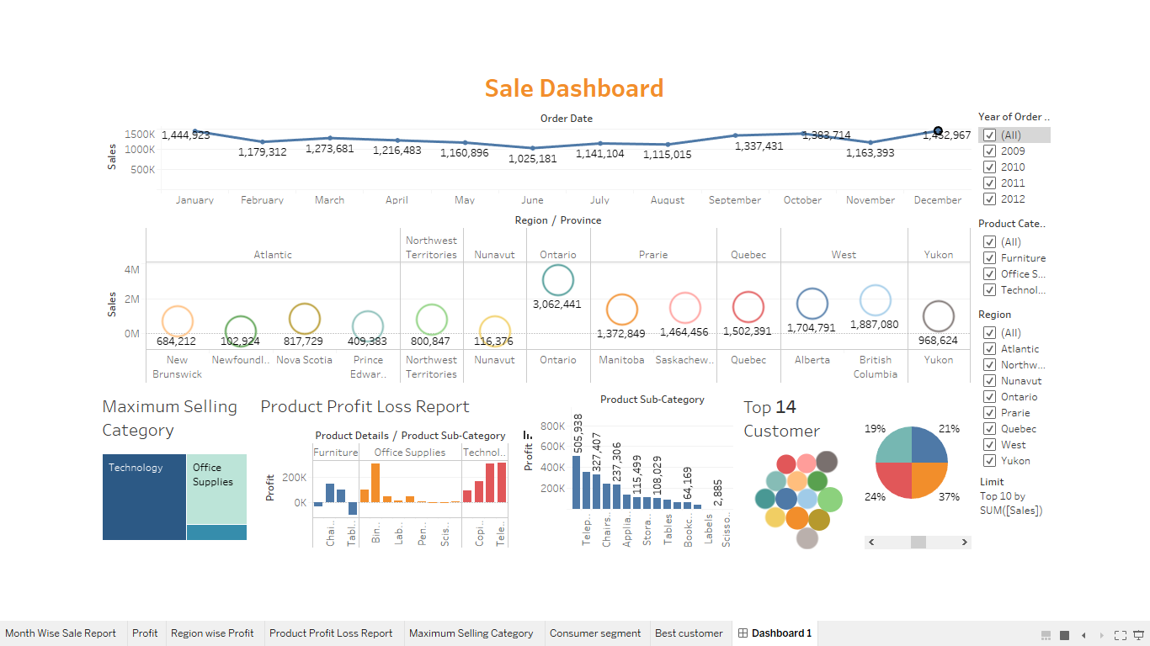
User Fendley Sales Dashboard

